Slide 1
“Contagion from market price impact: a price-at-risk perspective”
Discussion by Silvia Pezzini (HKMA)
FSB Conference: Understanding and addressing systemic risks in non-bank financial intermediation, 8-9 June 2022
Session: Data and tools to enhance risk assessment and monitoring of the NBFI sector

Slide 2
Review of “Contagion from market price impact: a price-at-risk perspective”
Fukker, Kaijser, Mingarelli and Sydow (2022) analyse the effect of large-scale portfolio deleveraging on the price of bonds and equities traded on the market and how deleveraging shocks propagate through the financial system.
Why it matters
  Exposure to common assets as a conduit for indirect interconnectedness
  Fire-sale dynamics can escalate liquidity stress into solvency stress
Data sources
  ECB Securities Holdings Statistics: Portfolios of bonds and equities held by banks and investment funds in euro-area, recorded at market value
  ECB Centralised Securities Database: ISIN-level information on bonds, equities, issuers
  Daily trading prices and volumes of largest 10,000 securities by value in 2018-2020
Method
  Estimates security-level price impact as a function of traded volume
  Quantile regression to understand non-linear impact at the tail of the distribution
  Includes systematic component (market return) for price correlation typical of fire sales
  Exploits several dimensions of heterogeneity (e.g. by security type, sector, bond maturity, stock market cap) to incorporate real-life distributions in portfolios
Note: the last bar is the average of 1-3 Sep.

Slide 3
Comments on “Contagion from market price impact: a price-at-risk perspective”
Results
  Equity portfolios are more prone to cascading effects than bonds
  Cascading effects potentially the largest in stocks issued by small-cap non-financial corporations, especially when held in high concentrations by several investors
  Results in line with what observed with family office Archegos in March 2021
  Under tail scenarios of extreme deleveraging pressure, system-level losses can be up to three times higher than predicted average losses.
Contribution
  Cascading effects are important but very difficult to model - this paper manages to do just that.
  How? By exploiting the rich heterogeneity of granular data on real investment portfolios (e.g. by security type, sector, bond maturity, stock market cap) to incorporate real-life distributions and impacts.
  Important contribution when attempting to understand the financial stability risks posed by non-bank financial entities.
Note: the last bar is the average of 1-3 Sep.

Slide 4
Comments on “Contagion from market price impact: a price-at-risk perspective”
Suggestions for further improvements
Derivatives are increasingly used by non-banks to gain exposure to stocks without the associated reporting requirements. It would be useful to expand the scope of the analysis to derivatives, in addition to equities and bonds, in order to help understand the full chain contagion in financial markets.
It would be worth back-testing the price impacts with historical data during the 2008 financial crisis, in order to evaluate the effectiveness of the price impact quantile regression approach.
Note: the last bar is the average of 1-3 Sep.

Slide 5
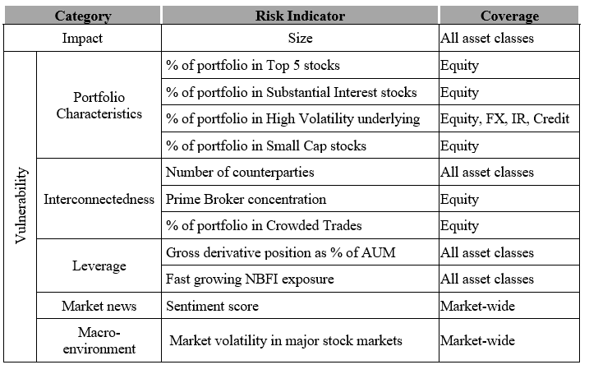
Experience from HKMA’s Monitoring Framework for NBFI Risk Assessment
Risk indicators for monitoring Non Bank Financial Intermediaries (NBFIs)
Impact indicator captures the size or systemic impact of the NBFI. Measured by NBFIs’ OTC derivative positions combined with bank borrowing.
Vulnerability indicators consist of five categories: portfolio characteristics, interconnectedness, leverage, market news/sentiment score, and macro-environment.
Various indicators combined to compute an overall risk score and generate NBFI watchlist
NBFI watchlist
NBFI risk indicators
Note: the last bar is the average of 1-3 Sep.

Slide 6
Experience from HKMA’s Monitoring Framework for NBFI Risks
Granular data useful for systemic risk monitoring, in particular when combining different data sources
Hong Kong Trade Repository (HKTR)
  OTC derivative transactions in five asset classes (Equity, Interest Rate, Foreign Exchange, Credit, Commodity) either booked or conducted in Hong Kong.
  Comprehensive set of data fields reported daily for each transaction, such as counterparty, notional value and the underlying asset of the derivative.
HKMA Granular Data Reporting (GDR) initiative
  Structured data at transaction level on banks’ lending activities, including loan amount, tenor, pricing, counterparty, collateral, etc.
Supervisory aggregate data
Public data sources
  Bloomberg, Standard & Poor’s Capital IQ on NBFI balance sheet measures (eg NAV, AuM)
Note: the last bar is the average of 1-3 Sep.

