Slide 1
Intraday Liquidity and Money Market Dislocations
by Adrien d’Avernas and Quentin Vandeweyer
FSB Discussion:
Marcin Kacperczyk (Imperial College)
June, 2022

Slide 2
Motivation
Money markets tend to face considerable dislocations
Repo rates tend to exhibit extreme behavior at times
Variation in overdraft rates
Nonlinear behavior between repo rates and repo lending
This paper:
(1) Propose the model to explain consistently the various dislocations
(2) Examine possible mechanisms in the data

Slide 3
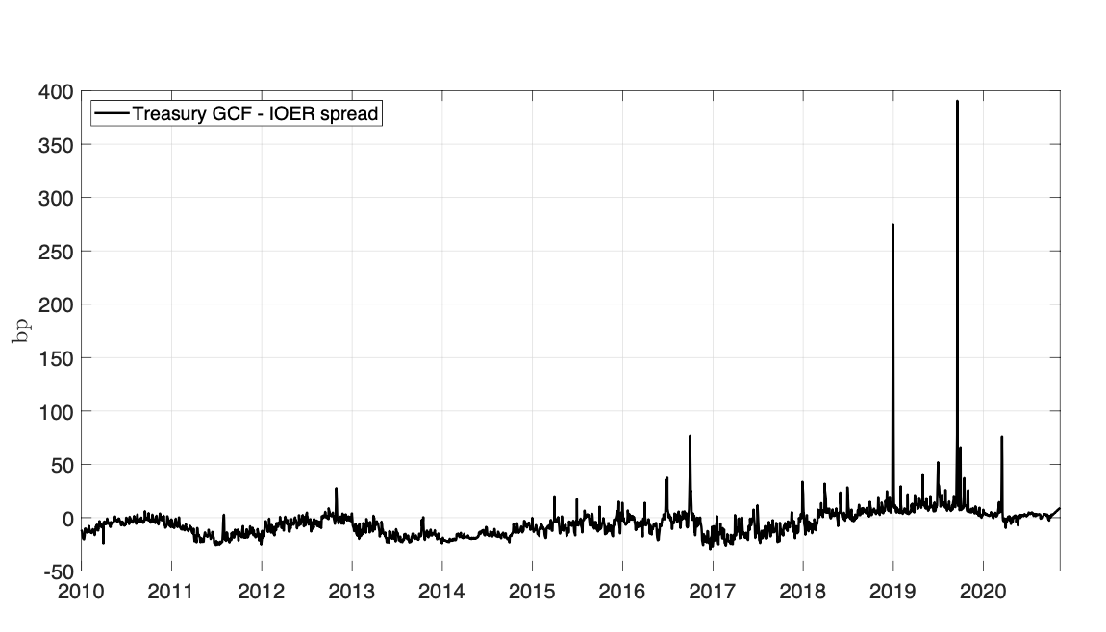
Repo spikes

Slide 4
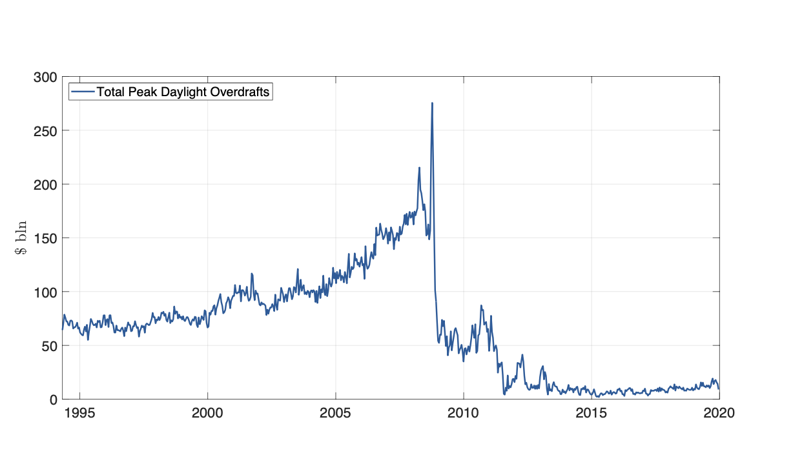
Daylight Fed Overdrafts

Slide 5
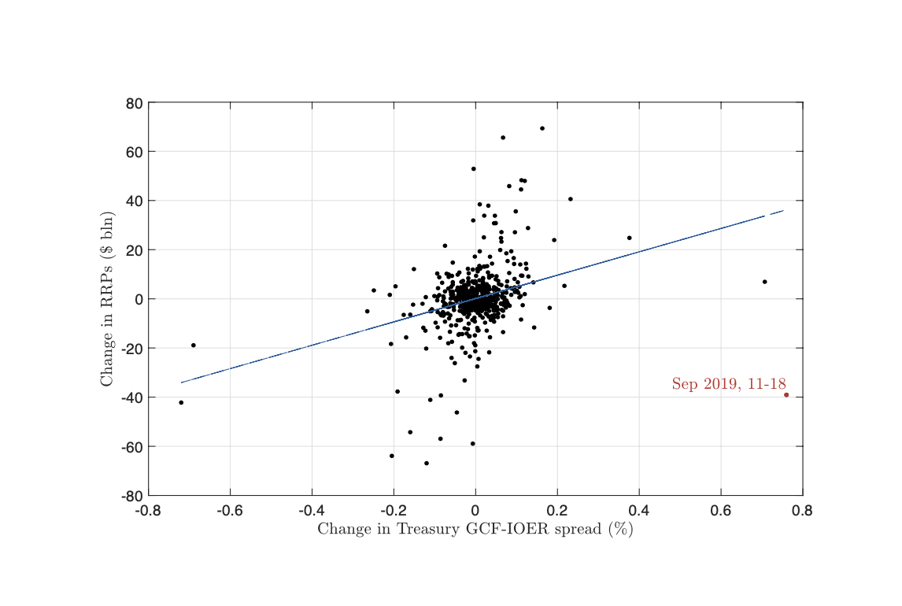
Nonlinearities

Slide 6
Motivation
Repo rates tend to exhibit extreme behavior at times
This paper:
(1) Propose the model to explain consistently the various dislocations
(2) Examine the fit of the model against specific dislocations in time (2019 & 2020)

Slide 7
Modeling Ingredients & Key Friction
Macro-banking model of the repo market
Focus on intraday activity: two periods (mornings and afternoons)
Interaction between banks and shadow banks
Shadow banks cannot issue deposits and no access to reserves
Banks can run a negative balance of reserves during the day (daylight overdrafts)
Banks subject to intraday liquidity regulation (intra-day liquidity stress test (LST) requires an extra buffer of reserves)
following Basel III regulation
hard constraint on the stock of reserves available for repo

Slide 8
Open Questions
Questions:
Why was the regulation introduced?
Is there some welfare improvement that you can show?
Did the change in regulation trigger a change in the arrival and magnitude of shocks?
Is there some room for quantitative predictions? How large should be the buffers?

